Slide 1
Mid Semester Presentation
on
ELECTRISTAIRS
SUBJECT CODE- MTR-251
Session: January- June 2021
Presented by: Shashwat, Sudeep, Preetinder,
Sankhyadip (Group-5)
UID: 19BEM1015,19BEM1027,19BEM1032,
20BEM8005
Project Supervisor
Name: Mrs. Jaspinder Kaur
UIE-Department of Mechatronics Engineering

Slide 2




HELLO!
We are a team of four members and our team is motivated to leave a mark in this university by means of our project ELECTRISTAIRS..
UIE-Department of Mechatronics Engineering

Slide 3
Introduction:
As we all know that we are moving towards the electrification of energy produced from non-renewable resources like petrol and diesel just as we can see in the case of Electric Vehicles. Which clearly indicates the increase in demand of electricity in future.
Chandigarh university has around 10,000 students studying. Each day hundreds of student climb stairs up and down, that’s a huge amount of Energy.. So why not to store and utilize it?
ELECTRISTAIRS, as the name suggests. It will transform the energy of students while climbing stairs to electricity which can be used for numerous applications.
UIE-Department of Mechatronics Engineering

Slide 4
Project Objectives:
Electricstairs method generates the electric power without polluting our environment.
The waste energy that is supplied by the human is being utilized in this system.
This method of power generation could be used for electrification in rural areas to fulfill our power needs.
This system seems to be very eco friendly from the environmental point of view also.
Proper implementation can help to meet down the extreme power demands in near future.
Promotes health and fitness by making them know value of their each step.
UIE-Department of Mechatronics Engineering

Slide 5
Procedure:
Firstly we will apply force on the tile so that piezoelectric crystal Plates and DC Alternator can be in action and can produce electricity.
The energy generated by piezoelectric crystal plates uses rectifier circuit to convert AC current to DC current.
After this we will use AC Ripple Neutralizer to remove the ripples and can give a smooth output.
Now it will pass through voltage regulator and filtration circuit to give a steady DC Voltage.
Then passing this voltage through unidirectional diode so as to prevent back EMF in the circuit.
But for the energy generated from DC Alternator will be directly passed through voltage regulator and filtration circuit followed by unidirectional diode.
Then we will combine the energy from both the diodes to voltage merge circuit arranged in parallel combination.
This will produce DC electricity that can be stored in Lithium Ion Batteries or can be directly used by passing through an Inverter to obtain 220V AC.
UIE-Department of Mechatronics Engineering

Slide 6
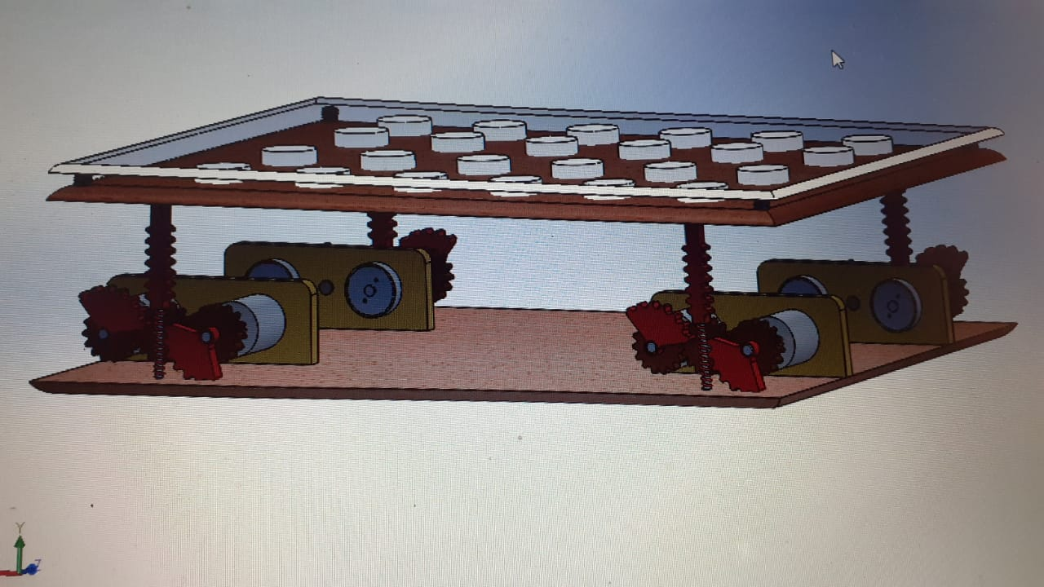
Spring
Piezoelectric Sensors
Plywood
Tile
Rack Gear with spring arrangement
Spur Gear
DC Motor and Alternator
Base Plate
Pinion Gear

Slide 7
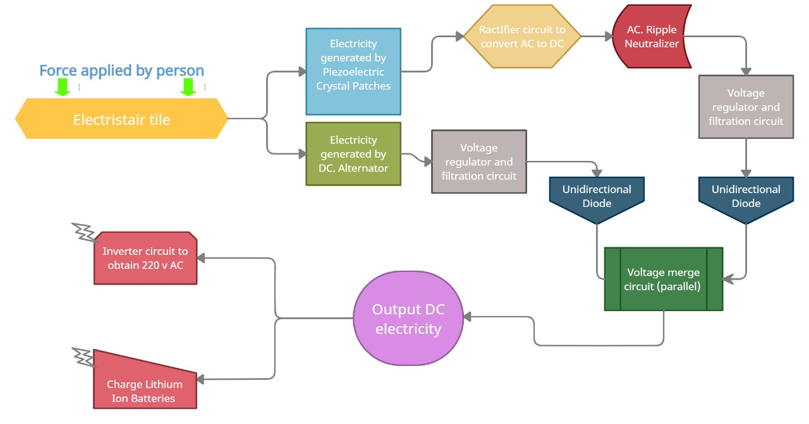

Slide 8
Work Plan & Present Work done:
Every team member has equally participated and contributed towards the making and implementation of this project toward success.
However, Sudeep came up with excellent Idea of Electricstairs and also helped the team by providing some 3D visualization for the various parts.
Preetinder helped the team by providing all the technical knowledge for improved structure and design of the Electricstairs.
Shashwat provided the required calculation for better efficiency and output of the project along with some minor detailing and presentation.
All the theoretical help was provided by Sankhyadip which include important articles related to the topic and other content like YouTube videos and all.
UIE-Department of Mechatronics Engineering

Slide 9

Pending Work:
As we are facing COVID-19 situation all across India. So it would not be possible to meet and give the project its final touch. So according to the situation we have produced with the simulation part only. Further we will update it as a realistic version. Also, we will try how we can use this mechanism to consume more electrical power from human energy.
UIE-Department of Mechatronics Engineering

Slide 10
Literature review:
S.No. | Author(s) | Type/Title of study
1 | Siba brata Mohanty, Sasank Shekhar Panda(2015) | Generation of electricity using foot step
2 | S.Krishna(2015) | Design of energy capturing medium using piezoelectric effect
3 | Mr.A.Adhithan, K.Vignesh, M.Manikandan(2015) | Proposed Method of Foot Step Power Generation Using Piezoelectric Sensor
4 | Y. C. Shu and IC Lien (2006) | Analysis of power output for piezoelectric energy harvesting systems
5 | U. K. Singh and R. H. Middleton(2007) | Piezoelectric power scavenging of mechanical vibration energy"
UIE-Department of Mechatronics Engineering

Slide 11
References:
[1Power Generation Using Foot Step 2011 v.Jose Ananth Vino, AP, Bharath University .
[2] Staircase power Generation Using Piezo-Electric Transducers 2013V. Prasannabalaji, R.Rakesh, S. Sairam and S. Mahesh Electronics and Instrumentation Engineering, Sri SaiRam Engg College, Chennai.
[3]Electricity generation from Footsteps 2010 S.S. Taliyan, B.B. Biswas, R.K. Patil and G. P.Srivastava Reactor Control Division, Electronics & Instrumentation Group and T.K. Basu IPR,Gandhinagar
[4]An investigation on generation of electricity using foot step 2015 Siba brata Mohanty, Sasank Shekhar Panda, Research scholar, Department of Industrial Engineering, G.I.E.T, Gunupur
[5] Power Generation from Staircase (Steps) 2014 Ramesh Raja R1, Sherin Mathew, UG Scholars, Department of Mechanical Engineering, RVS College of Engineering & Technology Dindigul, India
[6] Electricity Generation from Footsteps; A Regenerative Energy Resource 2013 Tom Jose V, Binoy Boban, Sijo M T SCMS School of Engineering and Technology, Kochi
[7] Power Generation Footstep 2014 Shiraz Afzal, Farrukh Hafeez Electronic Engineering Department, Sir Syed university of Engineering and technology, Karachi, Pakistan; Electrical and electronicengineeringDepartment,JubailIndustrialCollege,Jubail,SaudiArabia.
UIE-Department of Mechatronics Engineering

Slide 12
THANK YOU
UIE-Department of Mechatronics Engineering

